Slide 1
Sentimental Analysis on Amazon Reviews
Made by
Paul Andrew S – 3122 22 5001 090
Pawan Kumar Ramnani – 3122 22 5001 091
Sanjay M – 3122 22 5001 310

Slide 2
Abstract
This presentation is about our machine learning model focused on Sentimental Analysis.
This covers various text pre-processing tasks, feature extraction, model training, model comparing, evaluation and creating frontend.
The primary objective is to use machine learning models to predict whether a message is positive or negative.

Slide 3
Problem Statement
Sentimental Analysis on Amazon Reviews aims to analyze reviews from Amazon for a certain product.
It gives you a quick overview of all the reviews in a single glance, highlighting all the positive and negative points about the product.
The challenge lies in understanding sarcasm, processing data effectively and choosing a suitable model for classification.

Slide 4
Literature Survey
Traditional Machine Learning Approaches Pang et al. (2002) pioneered sentiment classification using machine learning techniques like Naive Bayes, Support Vector Machines (SVM), and Maximum Entropy. These methods rely on manually engineered features such as bag-of-words, TF-IDF, and n-grams, which have shown decent performance on structured data.
Logistic Regression in Sentiment Analysis Logistic regression remains a strong baseline model for binary sentiment classification tasks. According to studies by Medhat et al. (2014), it achieves reasonable accuracy with less computational complexity, making it ideal for quick prototyping and small-scale applications.
Ensemble Learning Methods Recent research (e.g., by Xia et al., 2011) has demonstrated that ensemble techniques like Random Forest, AdaBoost, and Gradient Boosting can significantly enhance prediction accuracy by combining the strengths of multiple models. These approaches help overcome the limitations of individual classifiers, especially in unbalanced datasets typical of real-world reviews.
Deep Learning and Transformer Models While our project focuses on classical machine learning, it’s worth noting that recent advances in deep
learning—especially models like LSTM, BERT, and RoBERTa—have outperformed traditional models in
most sentiment analysis benchmarks. However, they require more computational resources and extensive
labeled data.

Slide 5
Dataset
We chose the Amazon Reviews Dataset from Kaggle: Link
The dataset is saved as ‘train.csv’ and has three columns:
Rating – the rating of the review (1 for negative, 2 for positive)
Subject – the subject of the review
Review – the body of the review

Slide 6
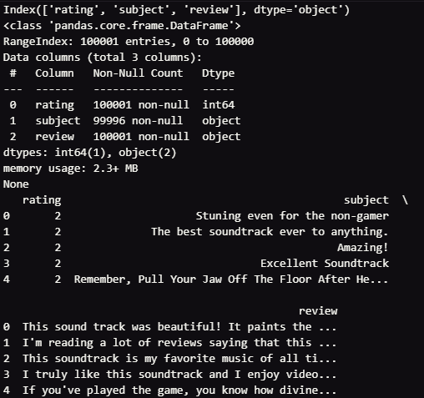
Exploratory Data Analysis
Dataset Info and Describe

Slide 7
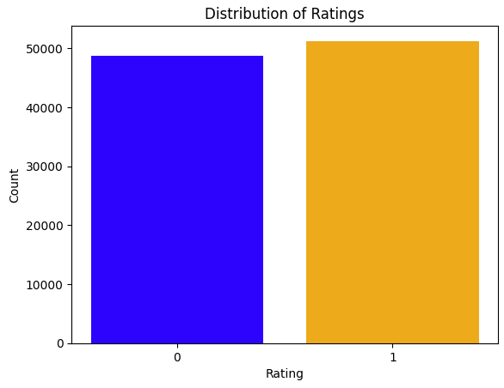

Exploratory Data Analysis
Distribution of Ratings in the Dataset

Slide 8
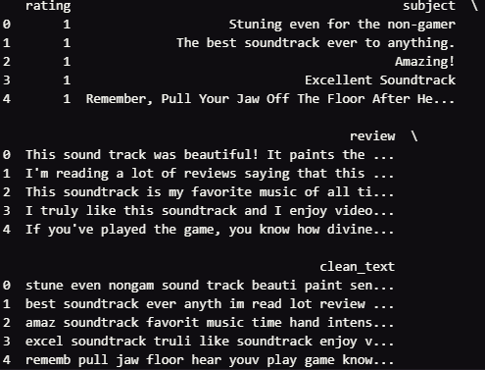
Preprocessing
We apply stop words and stemming along with other text preprocessing to obtain the cleaned review.

Slide 9
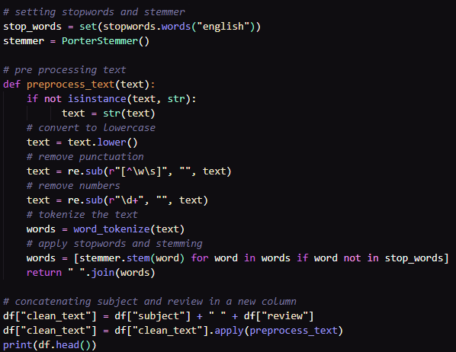
Preprocessing
Code for text preprocessing:

Slide 10

Feature Engineering
We used TFID Vectorizer to extract the top 5000 words.

Slide 11
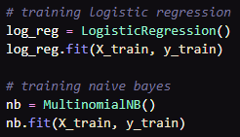
Models
We used 2 models
Logistic Regression
Naïve Bayes

Slide 12
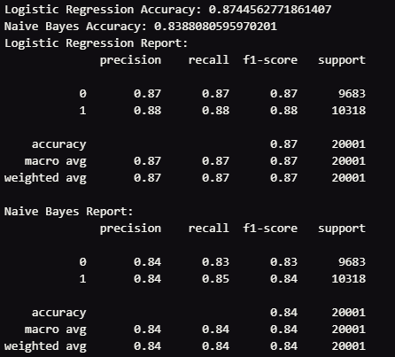
Performance Metrics

Slide 13
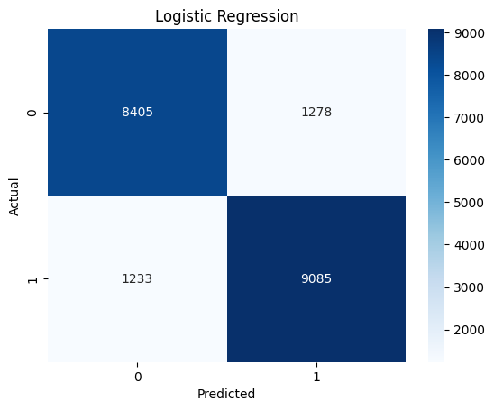
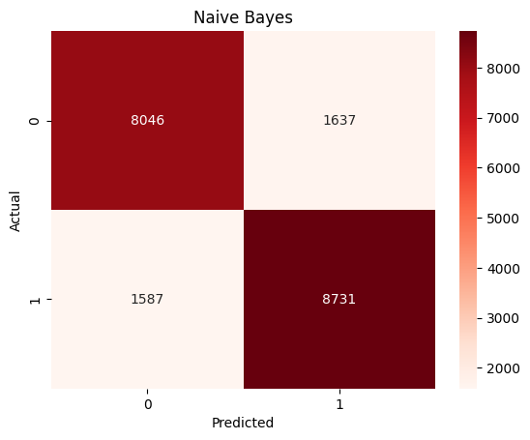
Confusion Matrix

Slide 14
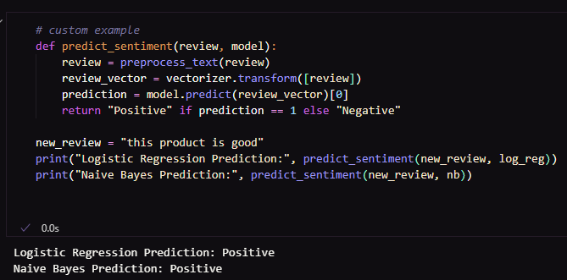
Testing with Custom Example

Slide 15
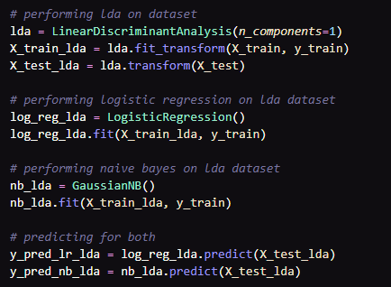
Dimensionality Reduction
We performed Dimensionality Reduction using Linear Discriminant Analysis (LDA) on our dataset.

Slide 16


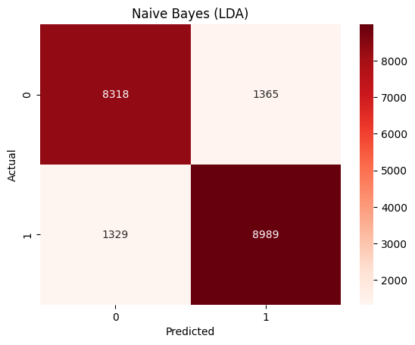
Performance Metrics after Dimensionality Reduction

Slide 17
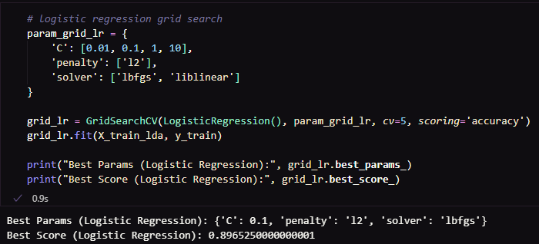
Using Grid Search
We used Grid Search for both Logistic Regression and Naïve Bayes to find the optimal parameters and the best score corresponding to those parameters.

Slide 18
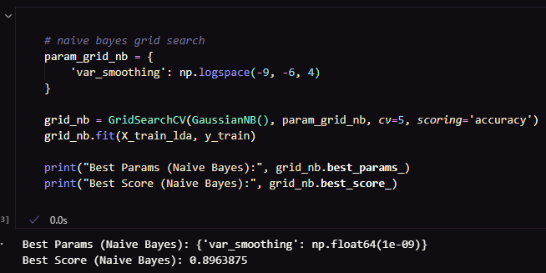
Using Grid Search

Slide 19
Ensemble Models
We used Ensemble models on our dataset to test their performance aswell

Slide 20
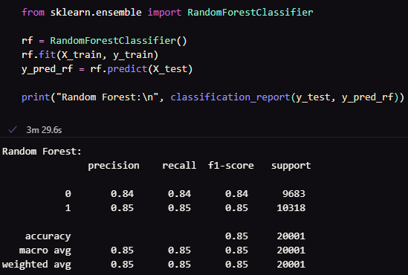
Random Forest

Slide 21
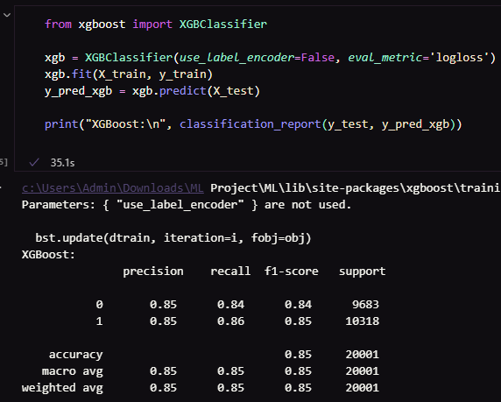
XGBoost

Slide 22
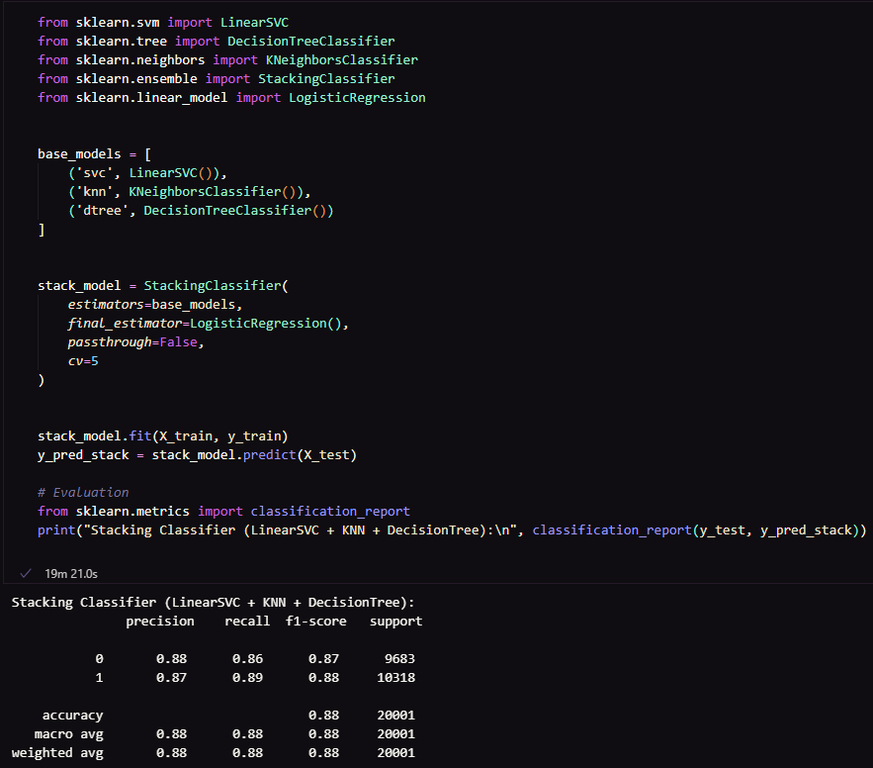
Stacking Classifier
We used stacking classifier with Linear SVC, K-Neighbors Classifier and Decision Tree.

Slide 23
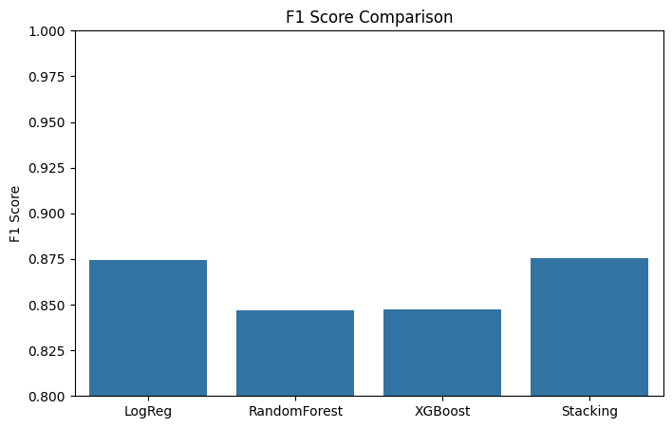
Performance Comparison

Slide 24
Conclusion
While Logistic Regression generally gives around 87% accuracy, after tuning it with the right parameters using GridSearch, it gives 89% accuracy.
This is better than Stacking Classifier using Linear SVC, Decision Tree and K-Neighbours (88%) by 1%.

